Slide 1



Supermarket
sales dashboard
Ninjas

Slide 2



Introduction
The dataset that we chose is one of the historical sales of a supermarket company which has been recorded in 3 different branches for 3 months.

Slide 3
Supermarket Sales Dataset
Details information about the dataset :
Invoice ID
Branches
City
Customer type (Members or normal)
Gender of the customer
Product line
Unit price of each product
Quantity of products
Total sales
Date of purchase
Time of purchase
Payment type (Cash , Credit card , or Ewallet)
cogs - cost of goods sold,
Gross margin percentage
Gross income
Rating of the store.

Slide 4

Dashboard
A dashboard is a visual display of all of your data. While it can be used in all kinds of different ways, its primary intention is to provide information at-a-glance, such as KPIs.

Slide 5
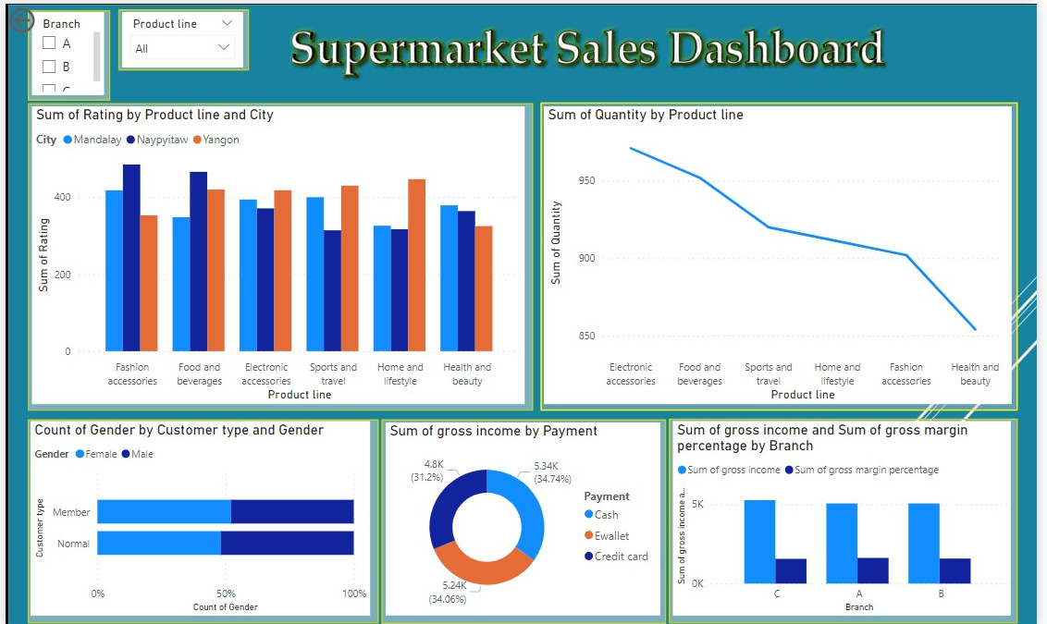
Supermarket Sales Dashbord

Slide 6
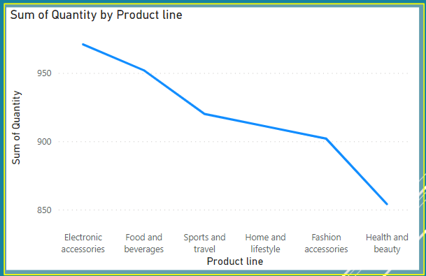
Sum of Quantity by Product line
Line chart shows the quantity purchased of all products lines.

Slide 7
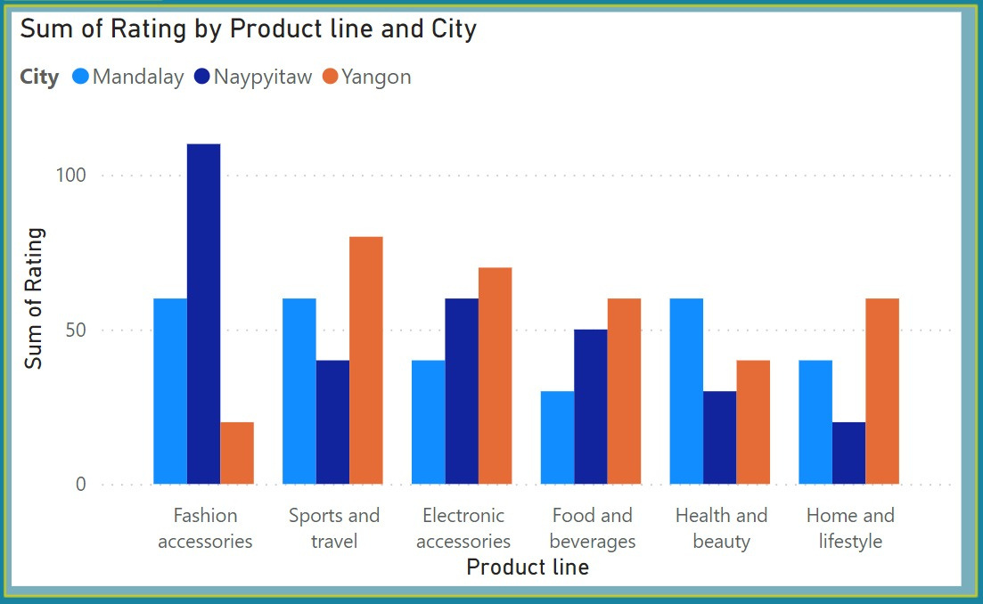
Sum of Rating by Product line and City
This is a clustered column chart that shows the sum of ratings for all product lines in all of the 3 cities.

Slide 8
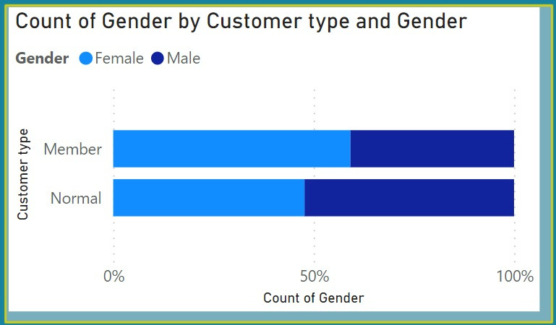
Count of Gender by Cutsomer type and Gender
This is a stacked bar chart to display the percentages of memberships between male and female customers

Slide 9
Action plans :
01
02
03
Marketing campaigns
Membership
incentives
Payment methods improvement

Slide 10

THANK YOU

